Slide 1

Digital Image Processing
Unit-1: Introduction
Dr. Piyush Joshi
Indian Institute of Information Technology
Sri City, Andhra Pradesh

Slide 2
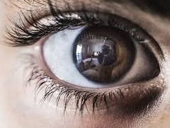
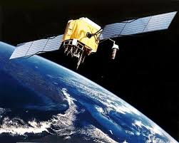
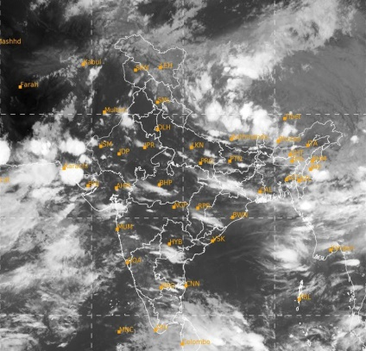
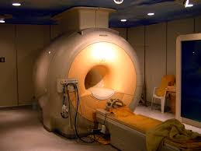
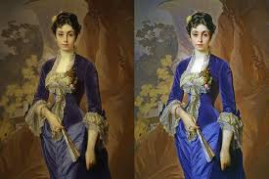

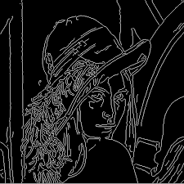
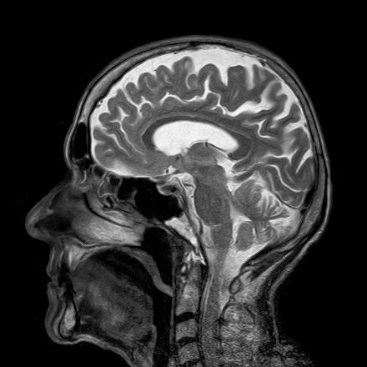
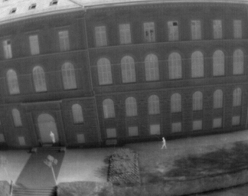
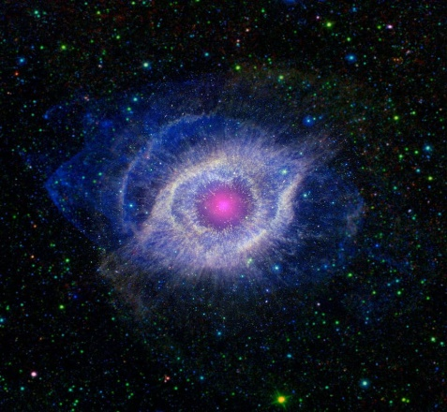
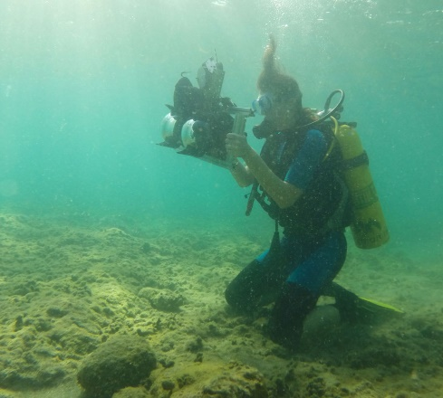
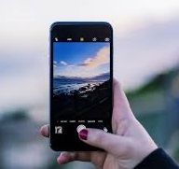
Welcome to DIP Monsoon 2022 Class

Slide 3

Relation with Other Fields
Mathematics
Document Analysis
Signal Processing
Physics
Machine Learning
Computer Vision
Machine Vision
Artificial Intelligence
Optics
Image Processing
Robotics
Neuroscience
Engineering
Algorithms, Graphics…
Biology
Computer Science

Slide 4
Prerequisites
Knowledge of Signals and Systems
Linear Algebra:
Matrices, Matrix Operations
Determinants, System of Linear Equations
Eigen Values, Eigen Vectors
Probability and Statistics:
Probability density function, Probability distribution
Mean, variance, co-variance, correlation
Priors, Posteriors, Likelihoods
Gaussian Distribution
Good programming skills

Slide 5
Course Topics: Sub-topics
Unit-1: Introduction
Introduction to digital image processing, elements of visual perception, image sensing and acquisition, image sampling and quantization, relationship between pixels.
Unit-2: Image Enhancement in Spatial Domain
Gray level transformations, histogram processing, spatial filters, smoothing and sharpening in spatial domain.
Unit-3: Image Enhancement in Frequency Domain
1-D Fourier transform and its inverse, 2-D discrete Fourier transform, discrete cosine transform, low pass filters, high pass filters, smoothing and sharpening in frequency domain.

Slide 6
Course Topics: Sub-topics
Unit-4: Image Restoration and Color Image Processing
Noise models, spatial domain filtering, frequency domain filtering, estimating degradation function, inverse filtering, Wiener filtering; multi-resolution processing: image pyramids, sub-band coding, Haar transform, Wavelet functions, 1-D and 2-D Wavelet transform, fast Wavelet transform; Color image processing: color models, color transformations. Advance algorithms.
Unit-5: Image Compression
Error free compression such as variable length coding, LZW, bit-plane coding, lossless predictive coding, Lossy compression such as Lossy predictive coding, transform coding, Wavelet coding, overview of compression standards. Advance algorithms.
Unit-6: Morphological Image Processing and Segmentation
Dilation, erosion, opening, closing, Hit-or-Miss transformation, basic morphological algorithms, image segmentation: segmentation using thresholding, region based segmentation, segmentation by morphological watersheds. Advance algorithms.

Slide 7
Learning Outcomes
Learn different types of image transformations and their properties.
Learn different techniques employed for the enhancement of images.
Learn different causes for image degradation and overview of image restoration techniques.
Understand the need for image compression and to learn the techniques of image compression.
Learn different feature extraction techniques for image analysis and recognition.
Develop any image processing application.

Slide 8
Grading Policy
Mid-Exam 20%
End-Exam 30%
Assignments 30%
Quizzes 20%

Slide 9
Assignments
Programming Language: Python, C, C++, Matlab
Programming Platform: Google Colab, Google Cloud Platform, Numpy, Matlab Toolbox
Submission Deadline: Must be submitted before the deadline specified for the assignment.
Penalty: You will get three additional days for submission with 25% of penalty, any submission after that will not be considered for evaluation.
Good / Bad Practices: Students are encouraged to complete the home works / assignments by their own. Any type of plagiarism may lead to heavy penalty.

Slide 10
Text / Reference Books
R. C. Gonzalez and R. E. Woods, Digital Image Processing, Prentice Hall, 4th edition, 2018.
A. K. Jain, Fundamentals of Digital Image Processing, Prentice Hall, 1995.
R. C. Gonzalez and R. E. Woods, Digital Image Processing with MATLAB, Prentice Hall, 2003.

Slide 11
Unit-1: Introduction
Sub-topics:
Introduction to Digital Image Processing
Elements of Visual Perception
Image Sensing and Acquisition
Image Sampling and Quantization
Relationship between pixels

Slide 12
Sub-topic: Introduction to Digital Image Processing
This lecture will cover:
What is a digital image?
What is digital image processing?
Why do we process images?
Source of digital imaging
A few examples of digital image processing
Key steps in digital image processing

Slide 13
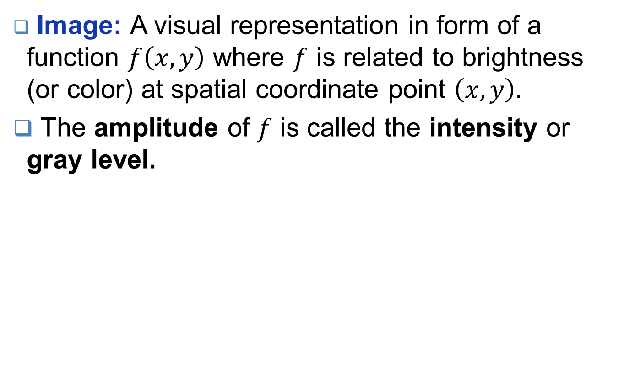
What is an image?
Image: A visual representation in form of a function $f\left(x,y\right)$ where $f$ is related to brightness (or color) at spatial coordinate point $\left(x,y\right).$
The amplitude of $f$ is called the intensity or gray level.

Slide 14
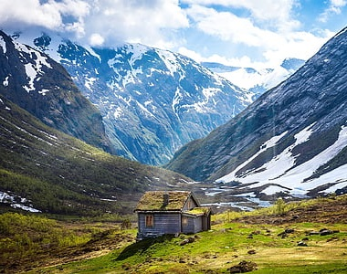

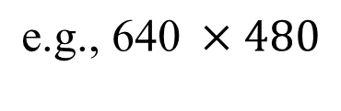
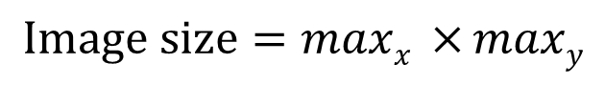
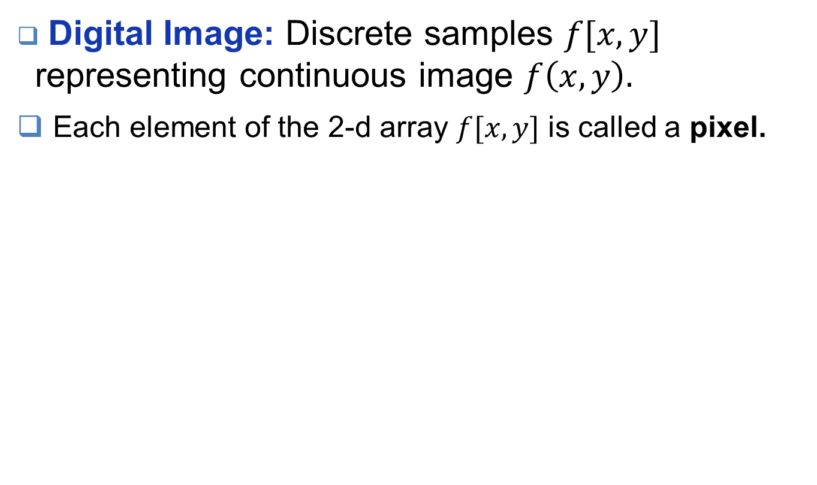

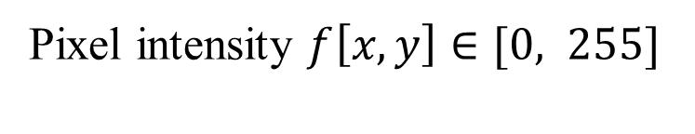
What is a digital image?
Digital Image: Discrete samples $f[x,y]$ representing continuous image $f\left(x,y\right).$
Each element of the 2-d array $f[x,y]$ is called a pixel.
column
pixel
$$x$$
row
$$Image size=\operatorname{maxx}{ ×}maxy$$
$$\text{e}\text{.}\text{g}\text{., 640} ×480$$
Pixel intensity $f\left[x,y\right]∈[0, 255]$
$$y$$

Slide 15

Imaging System

Slide 16
What is digital image processing?
DIP mainly focuses on
Improvement of pictorial information for human interpretation
Processing of image data for storage, transmission and representation for autonomous machine perception
DIP includes the following steps
Importing an image via image acquisition tools
Analyzing and manipulating the image
Extract information useful for the image analysis and computer vision tasks.
Any DIP system takes an image as an input and produce a processed image as an output.

Slide 17
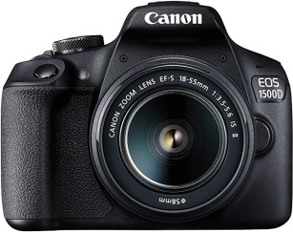
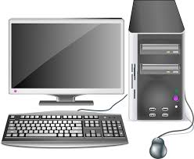
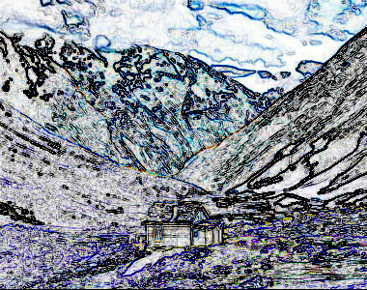
Digital Image Processing System
Input Image
Camera
3D World
Problem Specific Algorithm
Sobel
Filter
Processed Image
Input Image
Processed Image

Slide 18
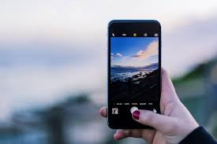
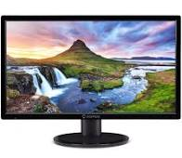
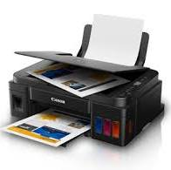
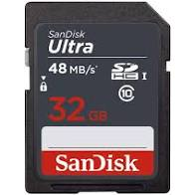
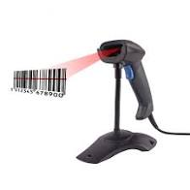
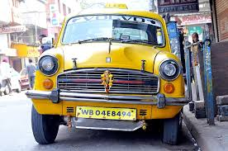
Why do we process images?
Acquire an image
Correct aperture and balance
Reconstruct image from projections
Prepare for display and printing
Adjust image size
Color mapping, gamma-correction, half-toning
Storage and transmission
Efficiently store an image in a digital camera
Send an image from space
Enhance and restore images
Improve visibility and color enhancement
Reduce noise in the capture image
Extract information from image
Read 2-d bar codes
Character recognition

Slide 19
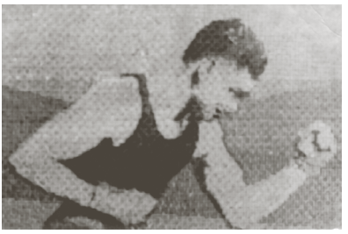
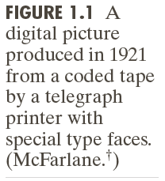
Origins of DIP
Sent by submarine cable between London and New York, the transportation time was reduced to less than three hours from more than a week

Slide 20
Origins of DIP

Slide 21
Image Sources
Electromagnetic (EM) energy spectrum
Acoustic
Ultrasonic
Electronic
Synthetic images produced by computer

Slide 22
Electromagnetic Energy Spectrum
Gamma-ray imaging: nuclear medicine and astronomical observations
X-rays: medical diagnostics, industry, and astronomy, etc.
Ultraviolet: lithography, industrial inspection, microscopy, lasers, biological imaging, and astronomical observations
Visible and infrared bands: light microscopy, astronomy, remote sensing, industry, and law enforcement
Microwave band: radar
Radio band: medicine (such as MRI) and astronomy

Slide 23
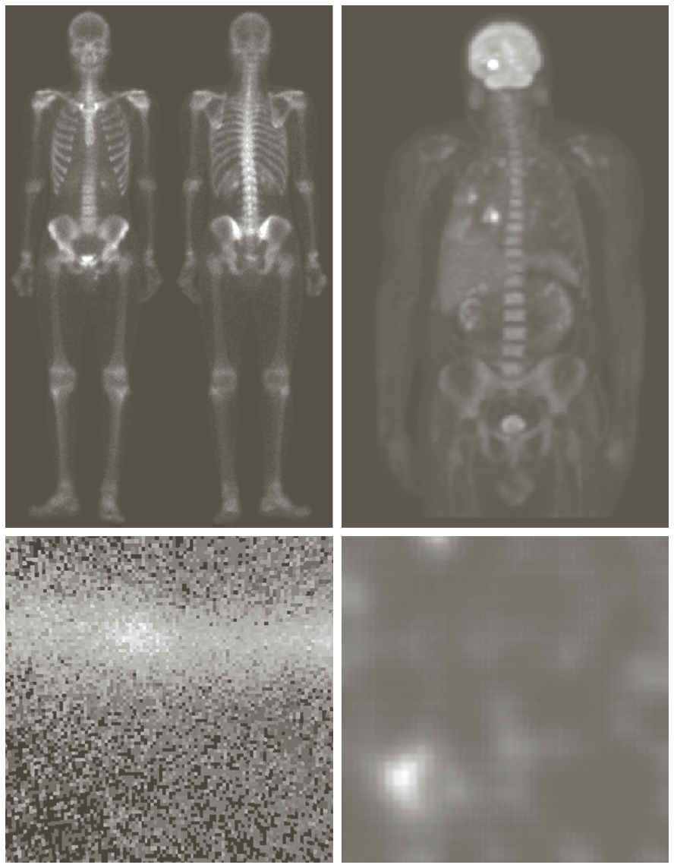
Gamma-Ray Imaging

Slide 24
X-Ray Imaging

Slide 25
Ultraviolet Imaging

Slide 26
Light Microscopy Imaging

Slide 27
Visual and Infrared Imaging

Slide 28
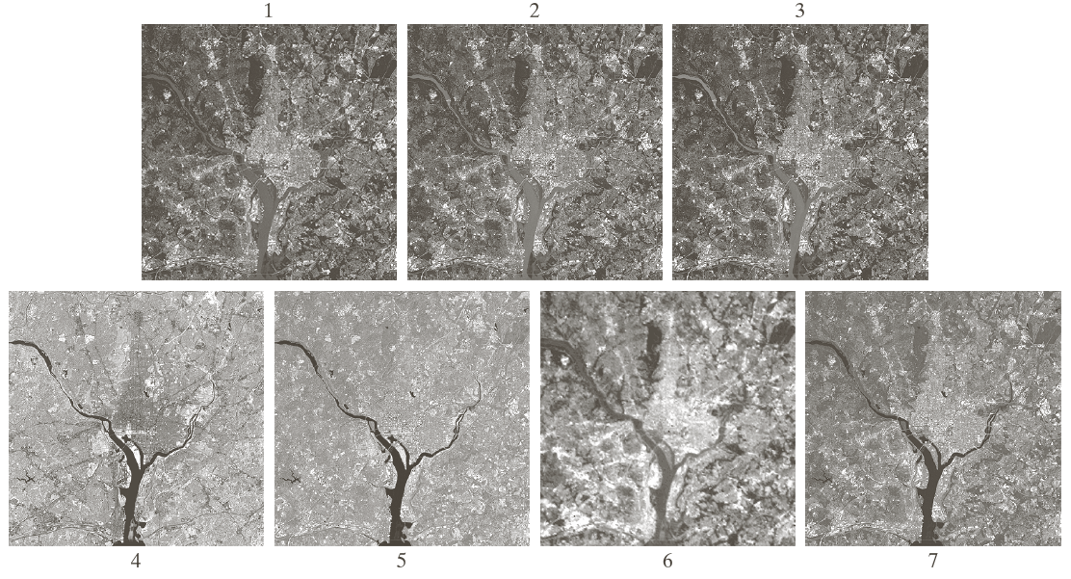
Visual and Infrared Imaging

Slide 29
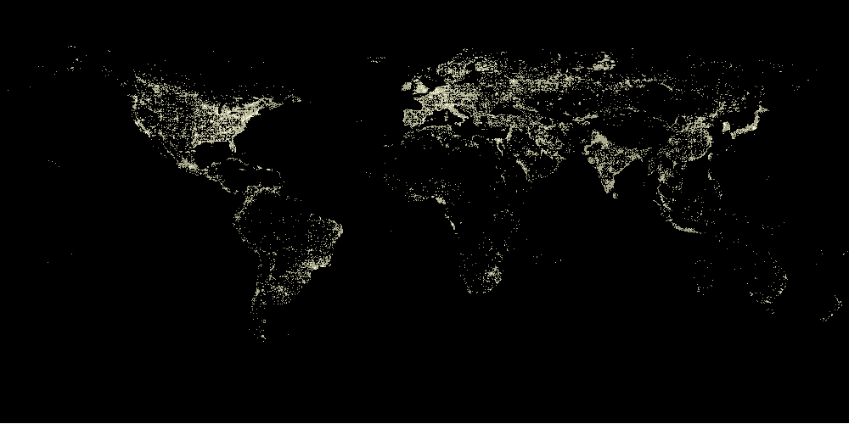
Infrared Satellite Image

Slide 30
Automated Visual Inspection

Slide 31
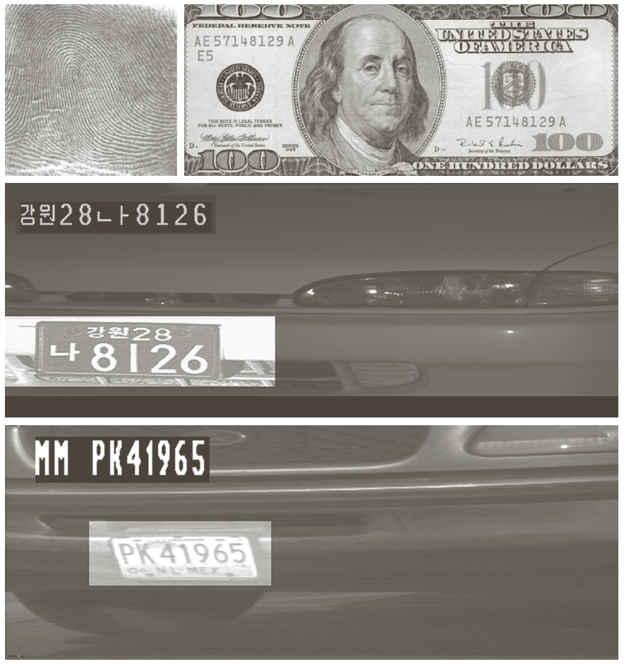
Automated Visual Inspection

Slide 32
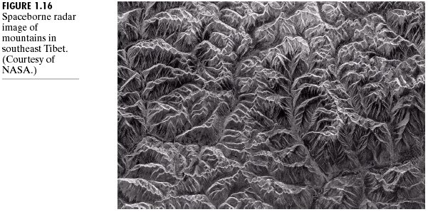
Microwave Band: Radar Image

Slide 33
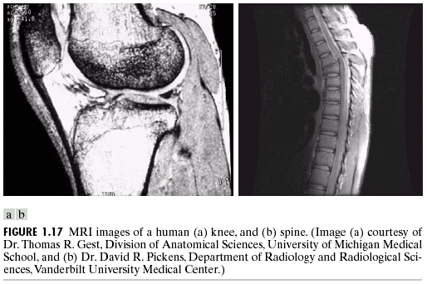
Radio Band

Slide 34
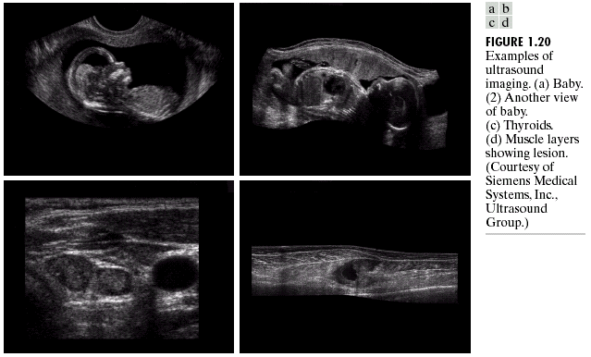
Ultrasound Imaging

Slide 35
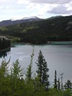
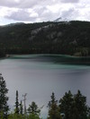
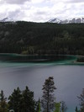
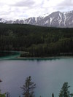
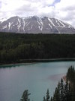
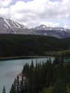
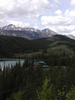
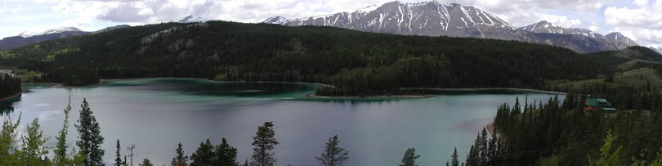
Image Processing Example
Image Stitching
Source: Vaibhav Vaish, Stanford CS223B Computer Vision, Winter 2007

Slide 36
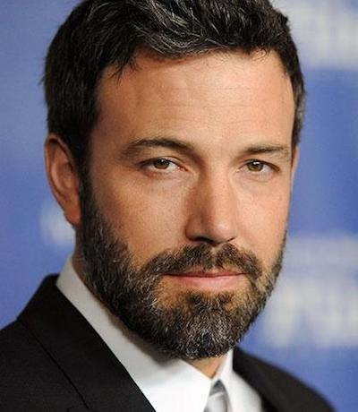
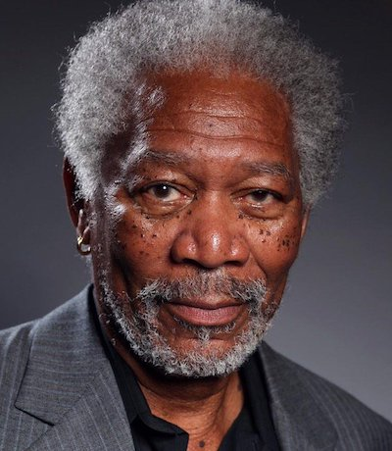
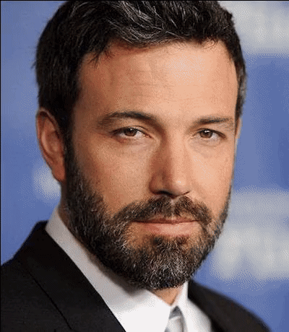
Image Processing Example
Face Morphing
Source:
https://github.com/cirbuk/face-morphing

Slide 37
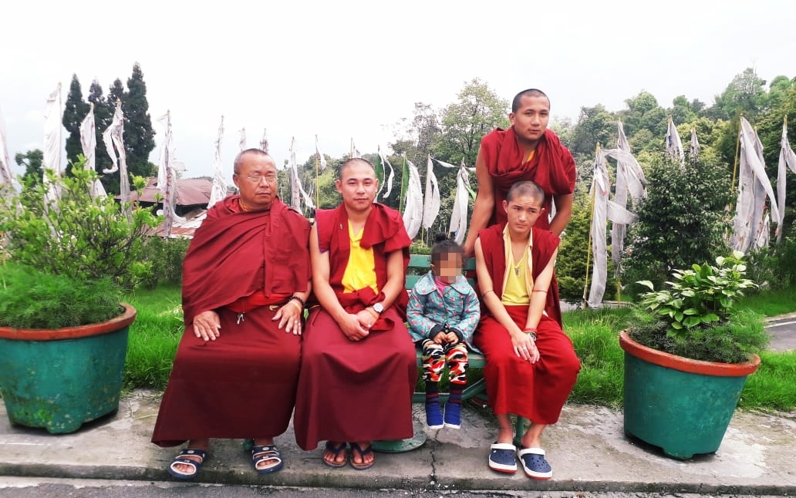
Image Processing Example
Face Blurring for Privacy Protection

Slide 38
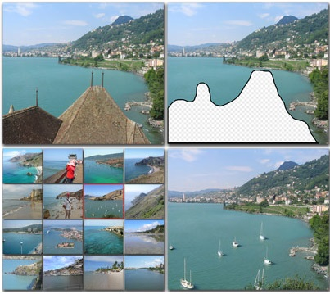
Image Processing Example
Image Inpainting
Source:
http://graphics.cs.cmu.edu/projects/scene-completion/

Slide 39
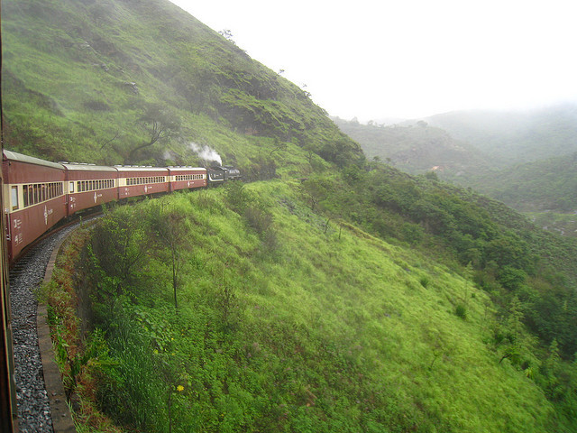
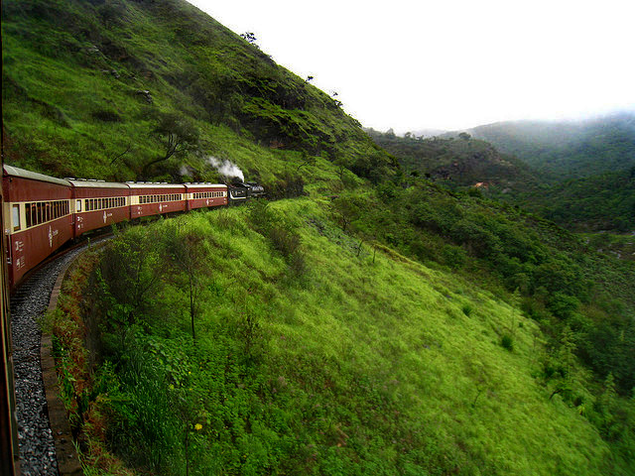
Image Processing Example
Image Dehazing
Source:
http://san-santra.github.io/comp_t18/

Slide 40

Image Processing Example
Image Retargeting
Source:
https://github.com/davidirobinson/image-retargeting

Slide 41
Key Steps in DIP
Image Restoration
Morphological Processing
Image Enhancement
Segmentation
Image Acquisition
Representation
& Description
Problem Domain
Colour Image Processing
Image Compression
Object Recognition

Slide 42
Key Steps in DIP: Image Acquisition
Image Restoration
Morphological Processing
Image Enhancement
Segmentation
Image Acquisition
Representation
& Description
Problem Domain
Colour Image Processing
Image Compression
Object Recognition

Slide 43


Key Steps in DIP: Image Enhancement
Image Restoration
Morphological Processing
Image Enhancement
Segmentation
Image Acquisition
Representation
& Description
Example: Contrast Stretching
Problem Domain
Colour Image Processing
Image Compression
Object Recognition

Slide 44


Key Steps in DIP: Image Restoration
Image Restoration
Morphological Processing
Image Enhancement
Segmentation
Image Acquisition
Representation
& Description
Example: Noise
Removal
Problem Domain
Colour Image Processing
Image Compression
Object Recognition

Slide 45

Key Steps in DIP: Morphological Processing
Image Restoration
Morphological Processing
Image Enhancement
Extract attributes
Segmentation
Image Acquisition
Representation
& Description
Problem Domain
Colour Image Processing
Image Compression
Object Recognition

Slide 46


Key Steps in DIP: Segmentation
Image Restoration
Morphological Processing
Image Enhancement
Segmentation
Image Acquisition
Representation
& Description
Divide image in constituent regions
Problem Domain
Colour Image Processing
Image Compression
Object Recognition

Slide 47

Key Steps in DIP: Rep. & Des.
Image Restoration
Morphological Processing
Image Enhancement
Segmentation
Image Acquisition
Representation
& Description
Image regions transformed
Problem Domain
Colour Image Processing
Image Compression
Object Recognition

Slide 48

Key Steps in DIP: Object Recognition
Image Restoration
Morphological Processing
Image Enhancement
Segmentation
Image Acquisition
Representation
& Description
The third image is the correlation
coefficient of the first two images
Problem Domain
Colour Image Processing
Image Compression
Object Recognition

Slide 49

Key Steps in DIP: Image Compression
Image Restoration
Morphological Processing
Image Enhancement
Segmentation
Image Acquisition
Representation
& Description
Two JPEG compression and reconstruction, difference with
original image, and a zoomed portion of the reconstructed image
Problem Domain
Colour Image Processing
Image Compression
Object Recognition

Slide 50

Key Steps in DIP: Colour Image Processing
Image Restoration
Morphological Processing
Image Enhancement
Segmentation
Image Acquisition
Representation
& Description
Problem Domain
Colour Image Processing
Image Compression
Object Recognition

Slide 51
Unit-1: Introduction
Sub-topics:
Introduction to Digital Image Processing
Elements of Visual Perception
Image Sensing and Acquisition
Image Sampling and Quantization
Relationship between pixels

Slide 52
Elements of Visual Perception
Structure of the Human Eye

Slide 53

Elements of Visual Perception
Image Formation in the Eye
If $h$ is the height in $mm$ of the that object in the retinal image then the figure yields $\frac{15}{100}=\frac{h}{17}⇒h=2.55 mm.$
The retinal image is reflected primarily in the area of the fovea.

Slide 54
Unit-1: Introduction
Sub-topics:
Introduction to Digital Image Processing
Elements of Visual Perception
Image Sensing and Acquisition
Image Sampling and Quantization
Relationship between pixels

Slide 55
Image Sensing and Acquisition
Image Acquisition using Sensor Strips and Sensor Arrays

Slide 56
Image Sensing and Acquisition
Image Acquisition Process

Slide 57

Image Sensing and Acquisition
A Simple Image Formation Model
$$f\left(x,y\right)=i\left(x,y\right)∗r(x,y)$$
$f\left(x,y\right):$intensity at the point $\left(x,y\right)$
$i\left(x,y\right):$illumination at the point $\left(x,y\right)$
(the amount of source illumination incident on the scene)
$r\left(x,y\right):$reflectance at the point $\left(x,y\right)$
(the amount of illumination reflected by the object)
where $0<i\left(x,y\right)<∞$ and $0<r\left(x,y\right)<1$

Slide 58
Image Sensing and Acquisition
Some Typical Ranges of Illumination
Lumen - a unit of light flow or luminous flux
Lumen per square meter (lm/m²) - the metric unit of measure for illuminance of a surface
On a clear day, the sun may produce in excess of 90,000 lm/m² of illumination on the surface of the Earth
On a cloudy day, the sun may produce less than 10,000 lm/m² of illumination on the surface of the Earth
On a clear evening, the moon yields about 0.1 lm/m² of illumination

Slide 59
Image Sensing and Acquisition
Some Typical Ranges of Reflectance
0.01 for black velvet
0.65 for stainless steel
0.80 for flat-white wall paint
0.90 for silver-plated metal
0.93 for snow

Slide 60
Unit-1: Introduction
Sub-topics:
Introduction to Digital Image Processing
Elements of Visual Perception
Image Sensing and Acquisition
Image Sampling and Quantization
Relationship between pixels

Slide 61
Image Sampling and Quantization
Digitizing the coordinate values
Digitizing the amplitude values

Slide 62
Image Sampling and Quantization

